Slide 1
Unified Process

Slide 2
What is the Unified Process
A popular iterative modern process model (framework) derived from the work on the UML and associated process.
The leading object-oriented methodology for the development of large-scale software
Maps out when and how to use the various UML techniques

Slide 3
The Most Important UP Idea: Iterative Development
The UP(unified process) promotes several best practices, but one stands above the others: iterative development.
In this approach, development is organized into a series of short, fixed-length (for example, four week) mini-projects called iterations.
The outcome of each is a tested, integrated, into executable system.
Each iteration includes its own requirements analysis, design, implementation, and testing activities.

Slide 4
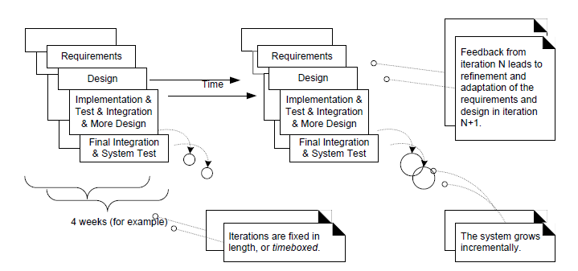
Iterative and incremental development
The system grows incrementally over time, iteration by iteration, and thus this approach is also known as iterative and incremental development.

Slide 5
Iteration result..
The result of each iteration is an executable but incomplete system.
The output of an iteration is not an experimental or throw-away prototype, and iterative development is not prototyping. Rather, the output is a production-grade subset of the final system.

Slide 6
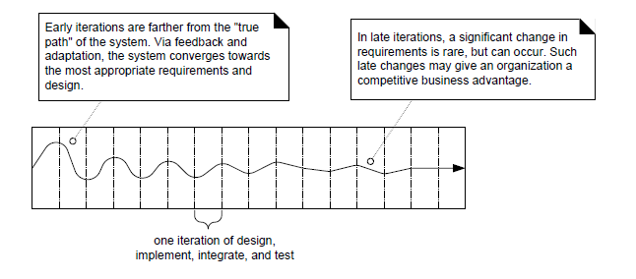
Iterative feedback and adaptation leads towards the desired system.

Slide 7
Benefits of Iterative Development
It includes:
early rather than late mitigation of high risks (technical, requirements, objectives, usability, and so forth)
early visible progress
early feedback, user engagement, and adaptation, leading to a refined system that more closely meets the real needs of the stakeholders
managed complexity; the team is not overwhelmed by "analysis paralysis" or very long and complex steps
the learning within an iteration can be methodically used to improve the development process itself, iteration by iteration

Slide 8
Iteration Length
The UP (and experienced iterative developers) recommends an iteration length between two and six weeks.
Much less than two weeks, and it is difficult to complete sufficient work to get meaningful throughput and feedback;
Much more than six or eight weeks, and the complexity becomes rather overwhelming, and feedback is delayed.
A very long iteration misses the point of iterative development.
Short is good.

Slide 9
Time-boxed
A key idea is that iterations are time boxed, or fixed in length.
For example, if the next iteration is chosen to be four weeks long, then the partial system should be integrated, tested, and stabilized by the scheduled date—date slippage is discouraged.
If it seems that it will be difficult to meet the deadline, the recommended response is to remove tasks or requirements from the iteration, and include them in a future iteration, rather than slip the completion date.

Slide 10
The UP Phases
A UP project organizes the work and iterations across four major phases:
1.Inception— approximate vision, business case, scope, vague estimates.
2.Elaboration—refined vision, iterative implementation of the core architecture, resolution of high risks, identification of most requirements and scope, more realistic estimates.
3.Construction—iterative implementation of the remaining lower risk and
easier elements, and preparation for deployment.
4.Transition—beta tests, deployment.

Slide 11
Imp point about phases.
This is not the old "waterfall" or sequential lifecycle of first defining all the requirements, and then doing all or most of the design.
Inception is not a requirements phase; rather, it is a kind of feasibility phase, where just enough investigation is done to support a decision to continue or stop.
Similarly, elaboration is not the requirements or design phase; rather, it is a phase where the core architecture is iteratively implemented, and high risk issues are mitigated.

Slide 12
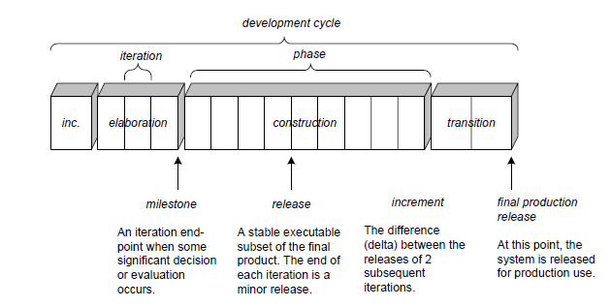
Schedule-oriented terms in the UP.

Slide 13
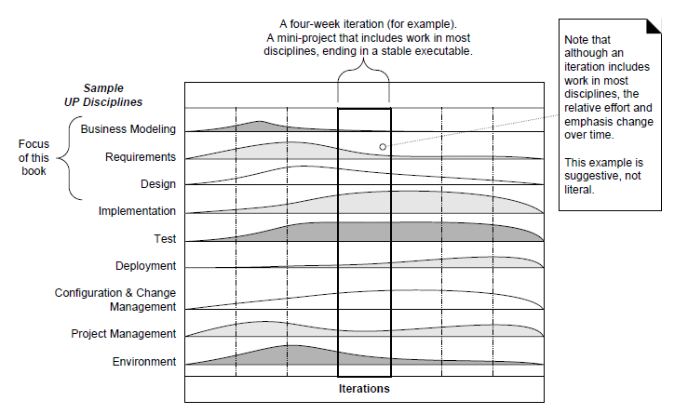
UP disciplines as Resource Histogram

Slide 14
Case Study on Unified Process
E-commerce Website Development:
A team of developers employed the Unified Process to build an e-commerce website for a retail company.
In the Inception phase, the team identified stakeholders (company executives, customers, suppliers), defined the business case (increased sales, improved customer experience), and outlined high-level requirements (product catalog, shopping cart functionality, payment processing).

Slide 15
The Elaboration phase involved refining requirements, elaborating use cases (e.g., browsing products, making purchases), and designing the system architecture to support scalability and security.
During the Construction phase, the website was developed iteratively, with features being implemented and tested in short iterations.
In the Transition phase, the website was deployed to production, and user feedback was gathered to identify any remaining issues or enhancements.

